Slide 1



BOOTCAMP
INFO SESSION

Slide 2

Please join through your laptop so that you can follow our steps

Slide 3


Join at slido.com #137062
ⓘ Start presenting to display the joining instructions on this slide.
Notes:
📣 This is Slido interaction slide, please don't delete it. ✅ Click on 'Present with Slido' and the joining instructions will appear when you get to this slide.

Slide 4
Ice-Breaker

Slide 5

Tell us which app on your phone is inseparable
ⓘ Start presenting to display the poll results on this slide.
Notes:
📣 This is Slido interaction slide, please don't delete it. ✅ Click on 'Present with Slido' and the poll will launch automatically when you get to this slide.

Slide 6









Android Apps

Slide 7
WHAT ARE ANDROID STUDY JAMS?
Android Study Jams are community-organized study groups for people to do hands-on learning for Android app development.
Android Basics is a series of sessions focused specifically on learning how to build Android apps without prior Android experience.

Slide 8
WHAT’S THERE FOR YOU

Slide 9
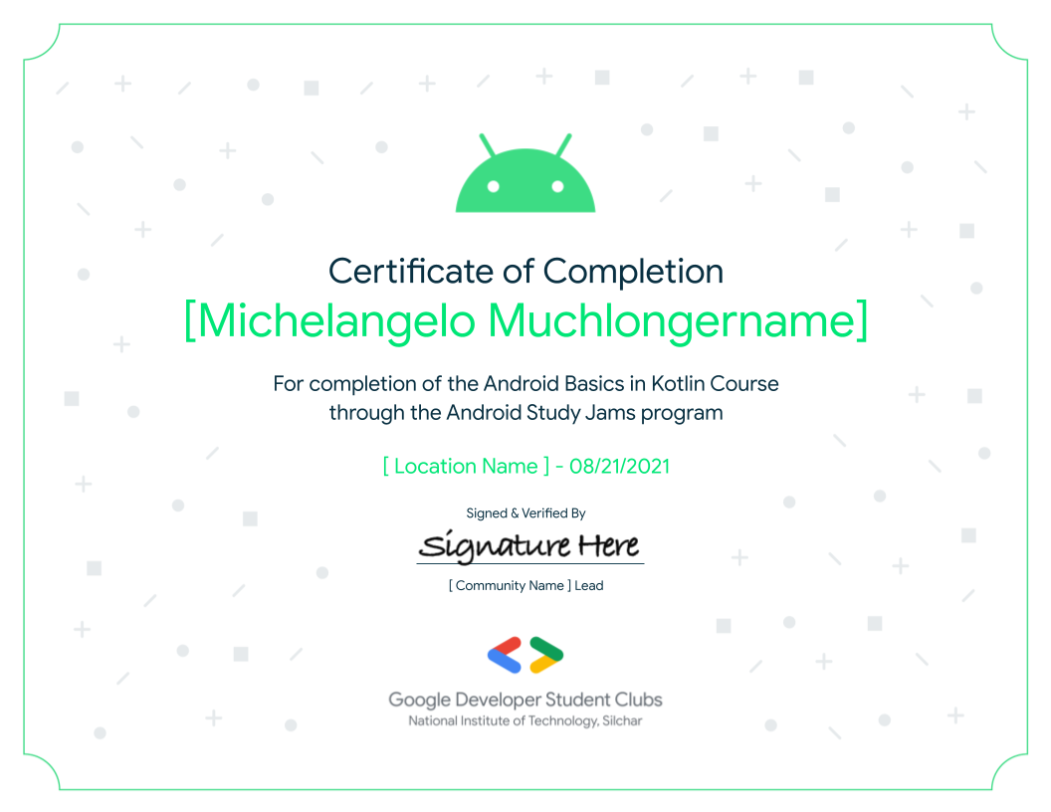

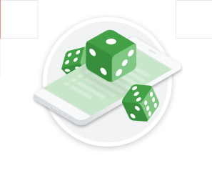

Skill Badges
Certificate

Slide 10
HOW TO ENROLL?

Slide 11

Google Form
Link: https://forms.gle/VTYBoSiUKGFLDtAF9

Slide 12
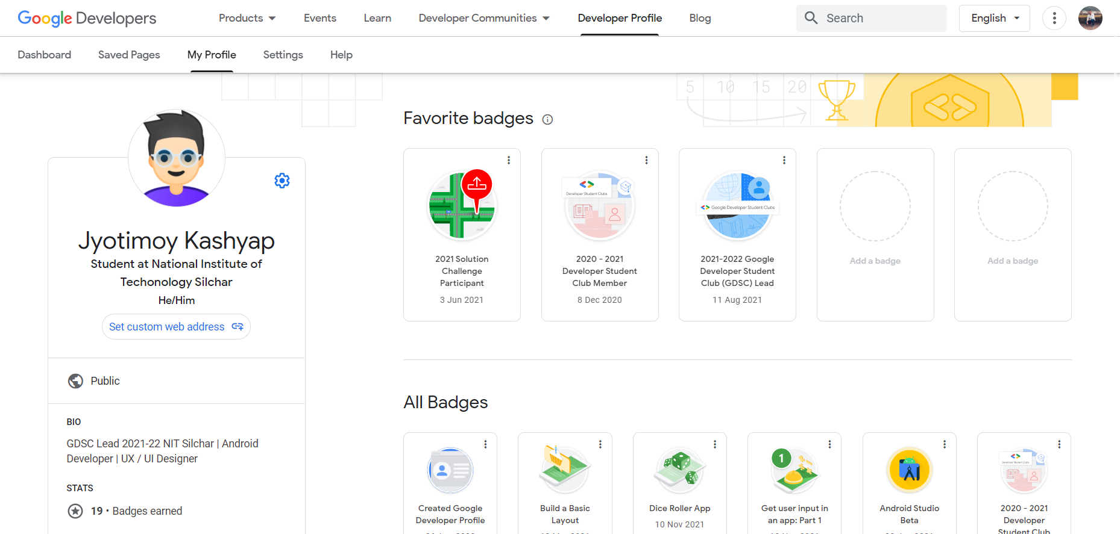
Developer Profile

Slide 13
Name any website which you want as an app
ⓘ Start presenting to display the poll results on this slide.
Notes:
📣 This is Slido interaction slide, please don't delete it. ✅ Click on 'Present with Slido' and the poll will launch automatically when you get to this slide.

Slide 14
Kotlin
A modern programming language that makes developers happier

Slide 15




Multiplatform Mobile
Server-side
Web Frontend
Android

Slide 16
BASIC SYNTAX

Slide 17
JJKSJDNCKS
MUTABLE VARIABLE
JDND
J Svar num : Int = 1
IMMUTABLE VARIABLE
val greetings = “Hello”

Slide 18
Int
Double
Boolean
Char
String

Slide 19
MATHEMATICAL OPERATORS + - * / %
INCREMENT AND DECREMENT OPERATORS ++ --
ASSIGNMENT OPERATOR =
COMPARISON OPERATORS > < >= <=
EQUALITY OPERATORS == !=

Slide 20
Simple Program
fun main( ){
println(“Hello”)
}

Slide 21
FUNCTIONS

Slide 22
fun addNumbers(var num1 : Int,var num2 : Int) : Int{
return num1+num2
}
fun main(){
var num1 : Int = 10
var num2 = 20
val total = addNumbers(num1,num2)
println("The result = $total")
}

Slide 23
COMPACT FUNCTIONS
fun double(x :Int) : Int{ //COMPLETE VERSION
x*2
}
fun double(x : Int) : Int = x*2 //COMPACT VERSION

Slide 24
CONCISE AND READABILITY

Slide 25
public class JoinClass {
private String classCode;
private String name;
public JoinClass(String classCode, String name) {
this.classCode = classCode;
this.name = name;
}
public String getClassCode() {
return classCode;
}
public void setClassCode(String classCode) {
this.classCode = classCode;
}
public String getName() {
return name;
}
public void setName(String name) {
this.name = name;
}
JAVA

Slide 26
data class JoinClass(var classCode : String, var name : String)
KOTLIN

Slide 27
CODE SAFETY
var playername : String
playername = null //compilation error
//KOTLIN PROTECTS YOU FROM MISTAKENLY OPERATING ON NULLABLE TYPES
var playername : String?=null //nullable types
println(playername.length()) //compilation error

Slide 28
INTEROPERABILITY

Slide 29
Kotlin provides . . .
Structured
Concurrency
Expressiveness
Safety
Interoperability
Lambdas
Data Classes
Scope Functions
Property access syntax
Nullability baked into type system
100% interoperability with Java programming language
Run aync operations in a scope, avoid leaking work and memory

Slide 30
Thanks for joining
Stay Tuned . . .

